Slide 1
SYS466: Analysis and Design using OO Models
Lecture 6: Sequence Diagrams – Database Access

Slide 2
Creating and Persisting Objects

Slide 3
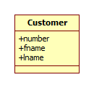
Example: Create Customer and persist to DB
Step 1: Create a customer object and populate it with the attributes provided
This can be modeled as one step (e.g. a constructor with arguments) or as several steps (neutral constructor then “set” operations)
Step 2: Persist the created object to the database

Slide 4
Example: Create Customer: two options
Use an ActionKind of “CREATE” in the properties for the create messages

Slide 5
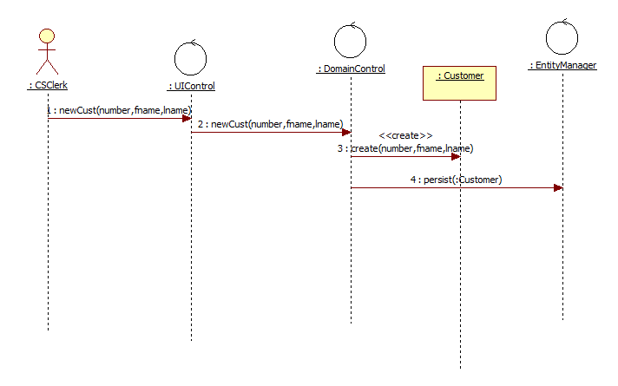
Example: Persist Customer
SYS466 convention: use persist(:anonymous object) or persist(named object) to indicate object is to be put into some permanent storage.
As per the layers pattern, only a controller object can communicate with the EntityManager

Slide 6
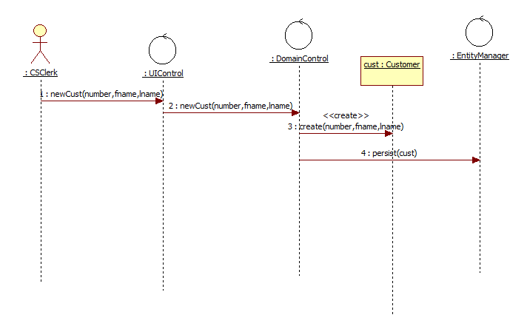
Example: Persist Named Customer

Slide 7
Retrieving Persisted Data

Slide 8
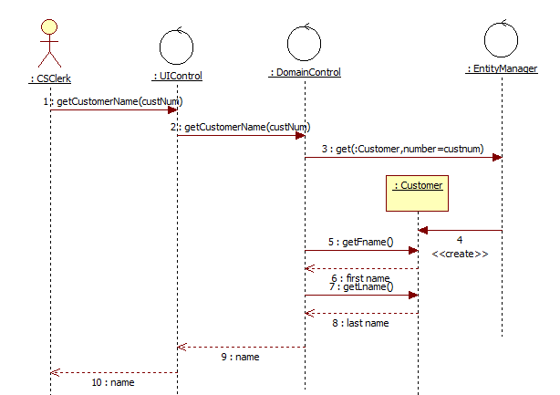
Example: Retrieve persisted data - single
SYS466 convention: use get(:anonymous object, key=value) or get(named object, key=value) to materialize an object from persistent storage
In our convention we show the EntityManager creating the object

Slide 9
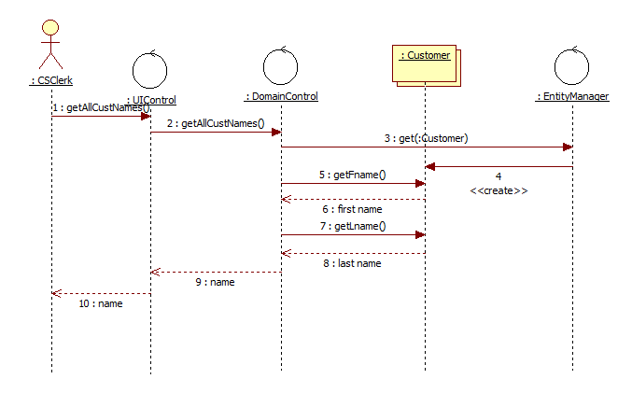
Example: Retrieve persisted data - multiple
SYS466 convention: use get(:anonymous object) with no key to materialize all objects of the specified class from persistent storage
In the the properties pane, select “IsMultiInstance” to indicate multiple instances of an object are being used in a SD.
In the Multi Instance object Customer, the fact that it is multi instance implies that the operations getFname and get Lname loop through all :Customer objects

Slide 10
Deleting Objects and Removing Persisted Data

Slide 11
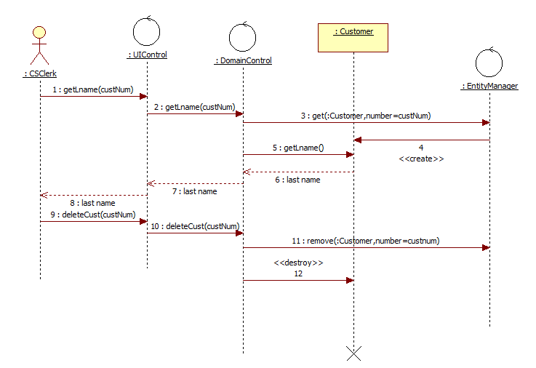
Example: Remove Customer and delete object
SYS466 convention: use remove(:anonymous object,key=value) to remove the data from persistent storage
To show deletion of the related object use a message with ActionKind “destroy”. An X will appear to show that the object’s lifeline has ended.

Slide 12
Retrieval and Reference Attributes

Slide 13
Example: Retrieving reference attribute objects
When getting objects from persistent storage, our convention is to assume that object attributes – reference attributes – are also materialized

Slide 14
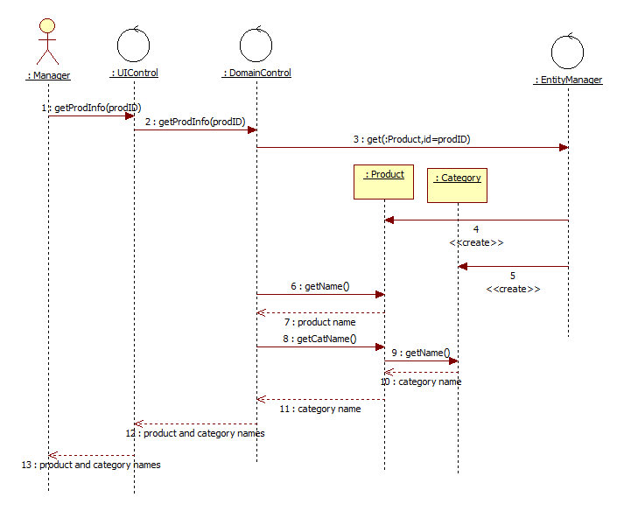
Example: Retrieving reference attribute objects
SYS466 convention: assume reference attribute objects are returned from persistent storage when the object that references them is returned.
In this example :Product is requested and its reference attribute :Category is also returned.
Showing the create in 5 is optional – it is often simpler to show the main object being created– Product in this case – and then show the referenced objects without having create messages.

Slide 15
Exercises

Slide 16
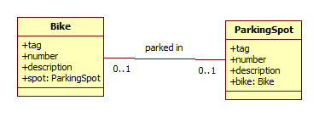
Exercise 1: Park Bike – draw the SD
Actor: Cyclist | System
Takes bike to parking spot. Uses phone to scan bike tag and scan parking spot tag. | System displays bike number and description and parking spot number and description (after retrieving from DB) Note: you have to have two separate calls to Entity Manager because the bike and parking spot are not yet related—bike doesn’t have a spot and the spot doesn’t have a bike
Requests to park bike in spot | Records parking spot in bike to show where it is parked and adds bike to parking spot to show that it is taken.

Slide 17
Exercise 2: Where is my bike?
Actor: Cyclist | System
Enters bike number | Displays Parking Spot number and description

Slide 18
Exercise 3: Which Bike is in this spot?
Actor: Parking Admin | System
Enters parking spot number | Displays Bike number and description

Slide 19
Exercise 4: Remove bike from spot
Actor: Cyclist | System
Scans bike tag | Displays bike description and parking lot number.
Confirms removal | Records that bike is removed from parking spot, and parking spot is no longer recorded in bike. Saves everything in persistent storage.

